Slide 1

Survey Methodology lab meeting – 2/14/2019
Visualization Basics - From Chart to Art
Additional Resources –
Visual Strategies: A Practical Guide to Graphics and Engineers, Frankel and Depace – 2012.
Color Design Workbook: A Real World Guide to Using Color in Graphic Design, Sean Adams, 2008.
Milestones in the History of Thematic Cartography, Statistical Graphics, and Data Visualization, Friendly & Denis http://euclid.psych.yorku.ca/SCS/Gallery/milestone/
Graphical Perception: Theory, Experimentation, and Application to the Development of
Graphical Methods. Cleveland & McGill 1984.
Articles found within https://www.pictureasportal.com/pages/resources

Slide 2
Visualization of Information -
This lecture is based off of a 400 level course on data visualization and statistics within the Climate and Space Department –
We build up on the statistics side from:
Basic and advanced statistics
(from t-test to bootstrap analysis)
Basic and advanced programming
(from reading in data to object oriented data analysis)
The complete labs (not lectures) can be freely accessed including(!) these slides at:
github.com/astro-abby/data_vis_statistics_geosciences

Slide 3
Visualization of Information -
How can we:
1) convey our data most informatively (accuracy)?
and…use the tools we have (In Python!), to
2) create interesting and approachable graphics (aesthetics)?

Slide 4

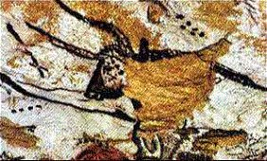
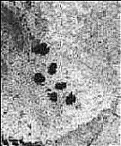
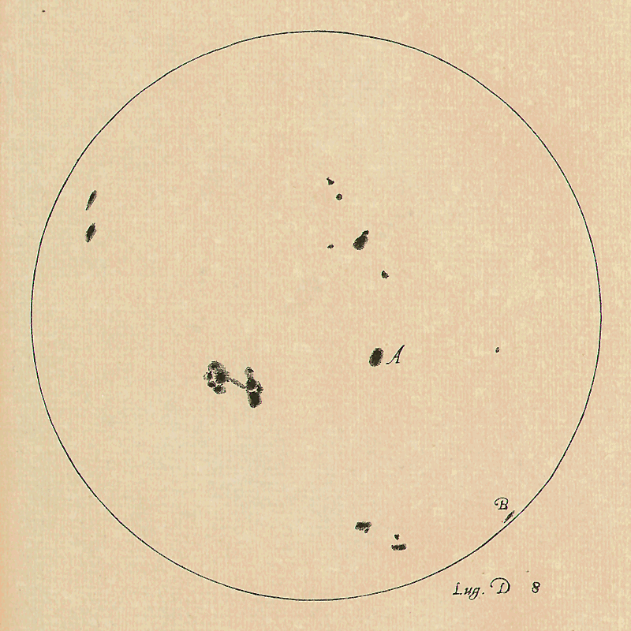
Brief History -
Exploring information about the natural world isn’t a new idea –
From ~ 16,500 years ago – interpretation of Pleides
http://news.bbc.co.uk/2/hi/science/nature/871930.stm
~10th century AD
“Ṣūrat al-Arḍ” (Picture of the World) from al-Iṣṭakhrī’s Kitāb al-masālik wa-al-mamālik (Book of Routes and Realms).
Medieval Islamic Maps : An Exploration – Pinto 2016
1612 AD
Galileo’s observation of sunspots
http://galileo.rice.edu/sci/observations/sunspot_drawings.html

Slide 5
The beginning of a more familiar statistical data visualization
With the beginning of modern statistics & probability theory in (late 1700s – 1900s) came a surge of info-graphics and visualizations
Let’s take a look at some of these early charts together – split into small groups around the papers handed out -
What these graphics are conveying (best guess)?
What you find familiar about them / unfamiliar?
What do you find confusing, what do you find interesting?

Slide 6
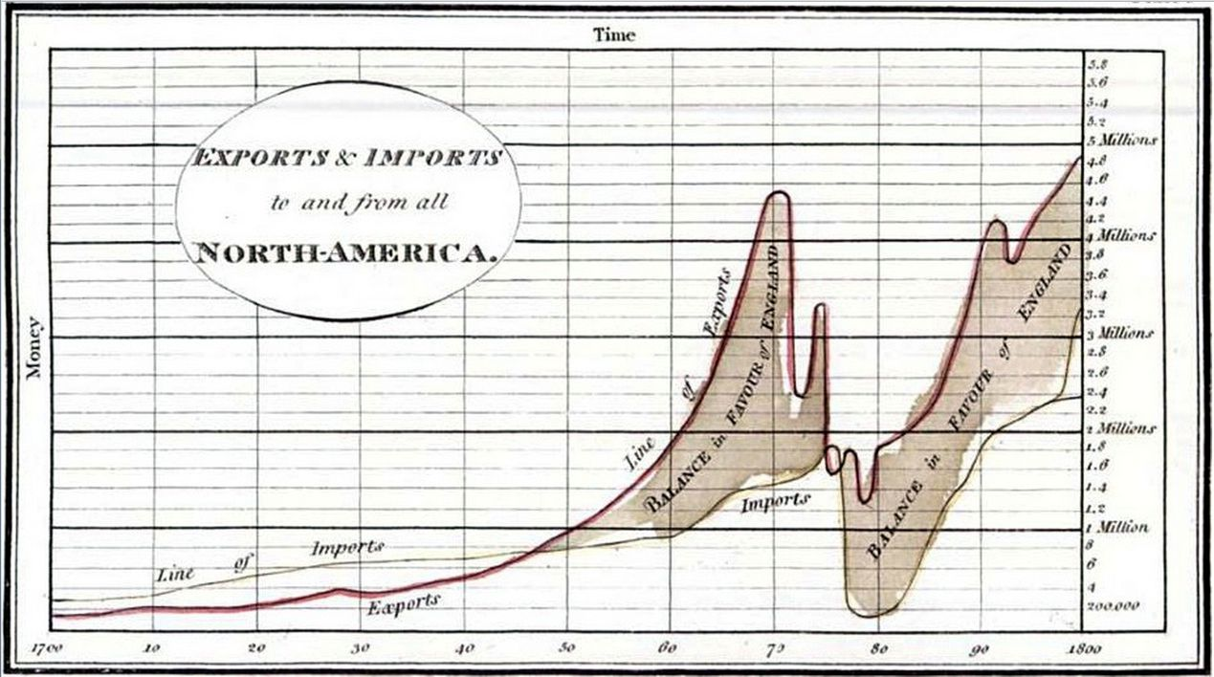
William Playfair’s Charts - 1786

Slide 7
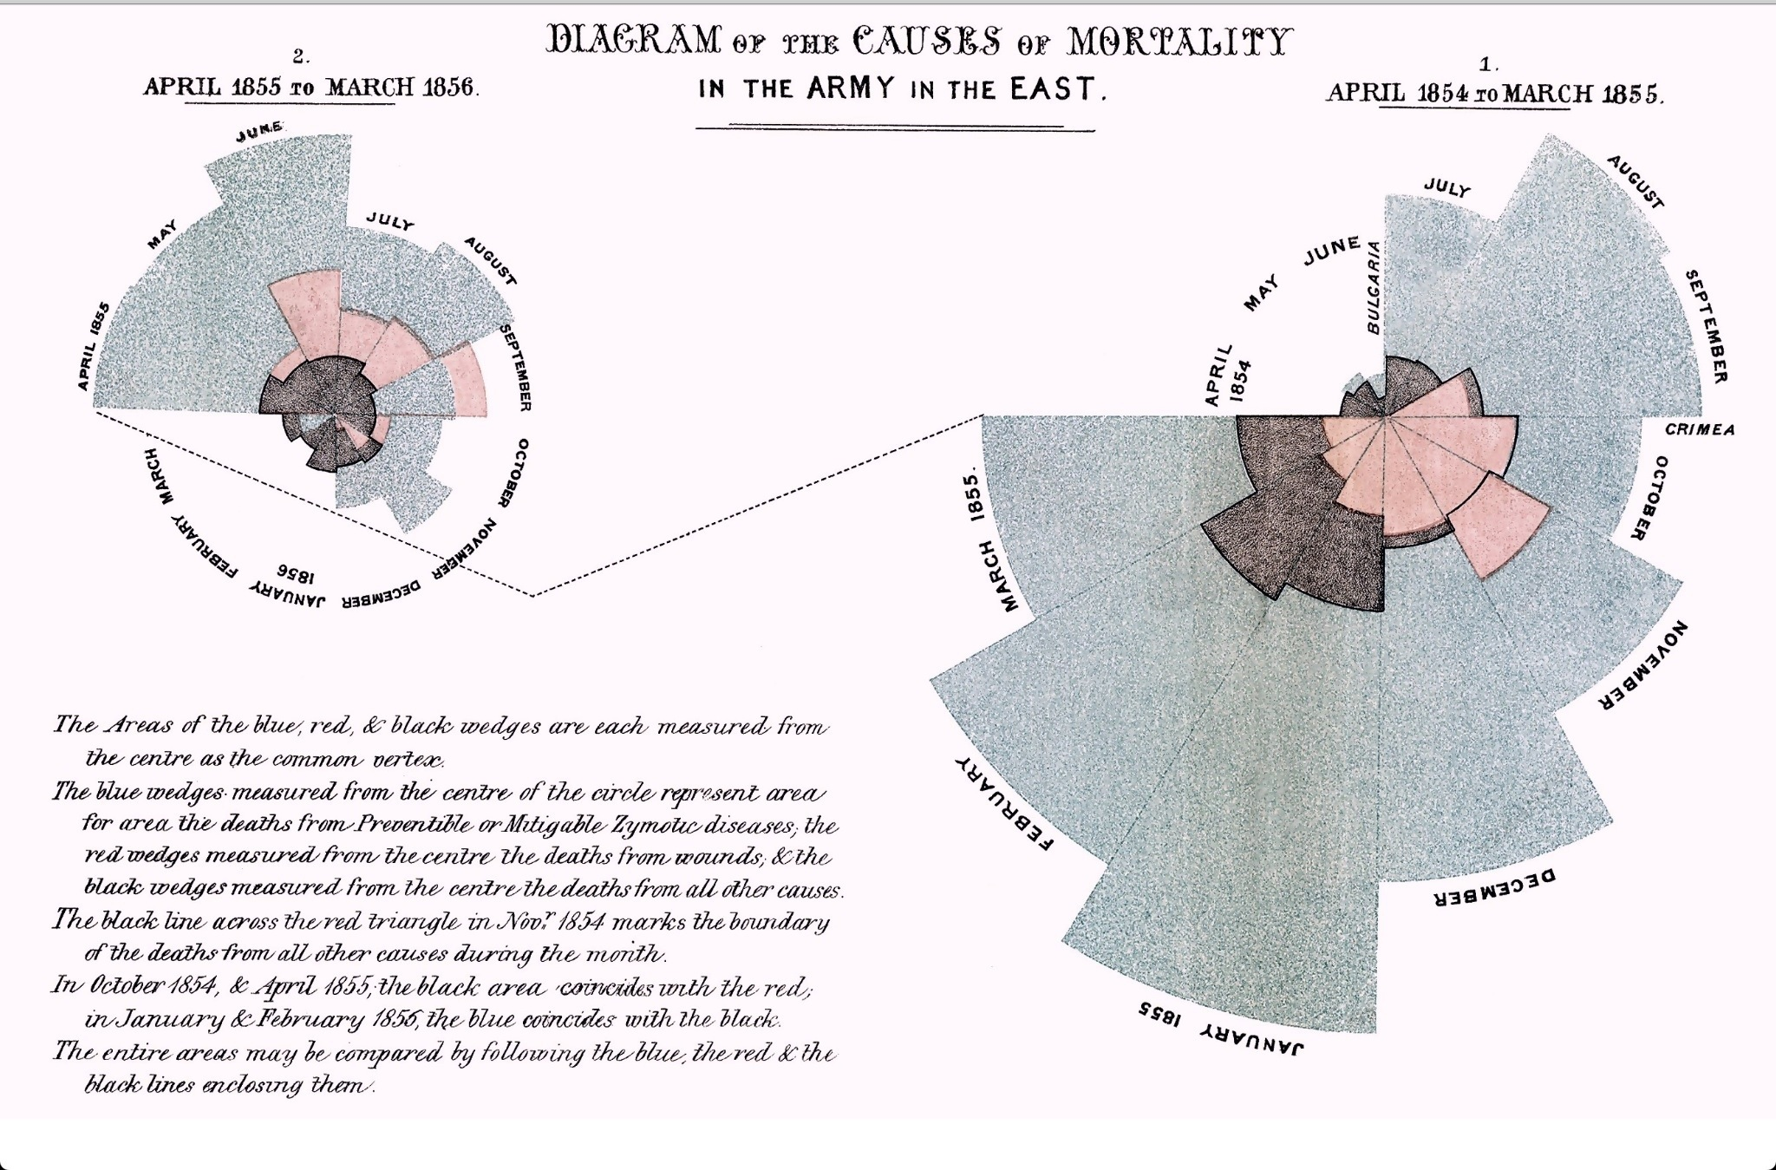
Florence Nightingale’s Report - ~1858

Slide 8
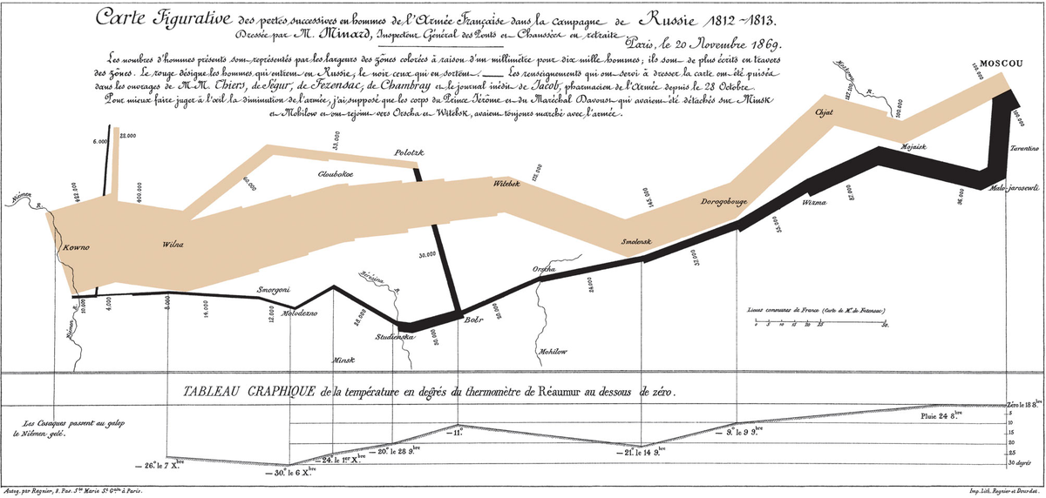
The “Minard Map” - 1869
Notes:
This has been called the best statistical drawing ever created.

Slide 9
What did these all have in common?
Why do you think they were made?

Slide 10
What did these all have in common?
Why do you think they were made?
The main point of these data graphics were to convince someone (mostly a government) of certain new ideas or realities
Their choice of presentation of the data is therefore made to create conversation around a certain topic or point -

Slide 11
What did these all have in common?
Why do you think they were made?
The main point of these data graphics were to convince someone (mostly a government) of certain new ideas or realities
Their choice of presentation of the data is therefore made to create conversation around a certain topic or point –
How can we implement “good design” as we make our own visualizations and infographics?

Slide 12
What constitutes a “good visualization”?
What do YOU think?

Slide 13
What constitutes a “good visualization”?
What do YOU think?
Does color matter?

Slide 14
What constitutes a “good visualization”?
What do YOU think?
Does color matter?
What colors are best?

Slide 15
What constitutes a “good visualization”?
What do YOU think?
Does color matter?
What colors are best?
Is 3D better than 2D?

Slide 16
What constitutes a “good visualization”?
What do YOU think?
Does color matter?
What colors are best?
Is 3D better than 2D?
What about interactive graphics? Are those better?

Slide 17
What constitutes a “good visualization”?
What do YOU think?
Does color matter?
What colors are best?
Is 3D better than 2D?
What about interactive graphics ? Are those better?
What it all comes down to is: – who is your audience, and what point are you trying to make.

Slide 18
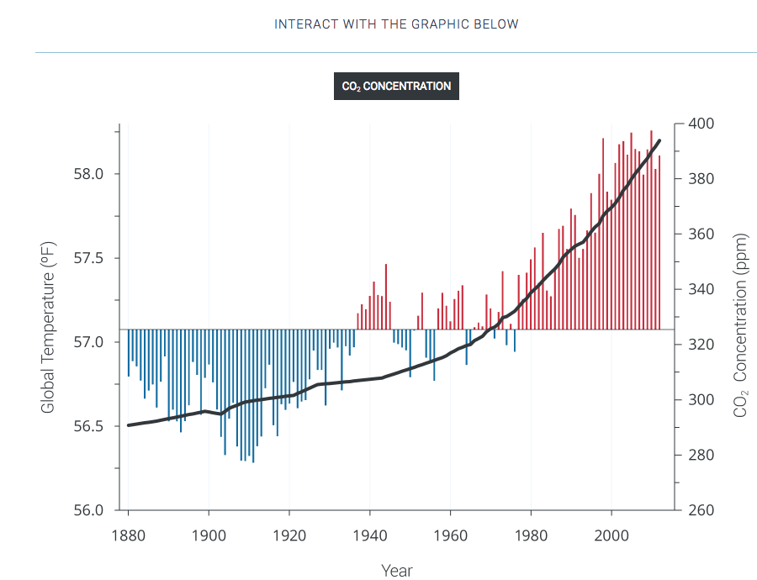
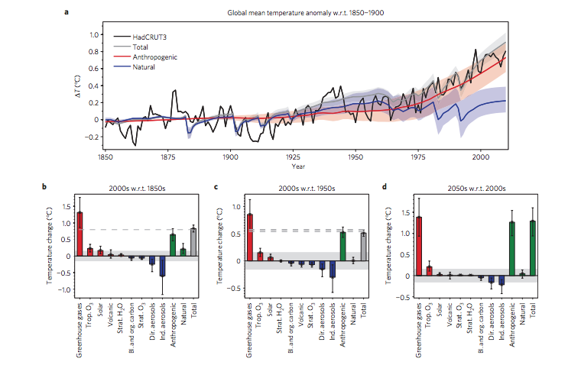
Recall our Audience Examples from Before?
Same Dataset
Audobon Society Climate Reports
National Climate Assessment 2014
Huber and Knutti, 2011

Slide 19
First Step Making a Visualization – Ask Yourself:
1) Is the graphic explanatory or exploratory?
Explanatory – you are trying to make a point, what is the point you are trying to make?
Exploratory – you are inviting the viewer to explore the dataset, make their own inferences
Often the very first graphics you make in your work are exploratory and then you finalize into an explanatory graphic.
Based on Frankel and DePace, 2012.

Slide 20
First Step Making a Visualization – Ask Yourself:
2) How will the graphic be used?
In an oral presentation you want something understood without much staring at the data – simplicity is best in this case
In a paper or a written document – perhaps more detail that invites the viewer to explore is better.
Above all – know you audience – what can you take for granted they know, what might they need as explanation
Based on Frankel and DePace, 2012.

Slide 21
First Step Making a Visualization – Ask Yourself:
3) What is the first thing you want the audience to see?
All graphics have a “flow” to them. Most audiences are familiar with bar charts, line plots etc – if you want to get creative try to make the viewer know where to look and what the message should be
You can use annotation, lines etc.
Just try to keep it simple.
For example…
Based on Frankel and DePace, 2012.

Slide 22
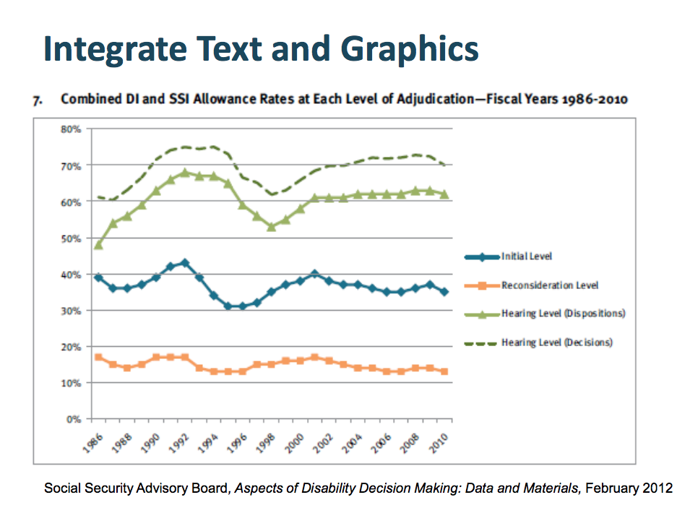
Example of accentuating communication
Adapted from Telling Visual Stories About Data, Congressional Budget Office, Fontaine, 2014.

Slide 23
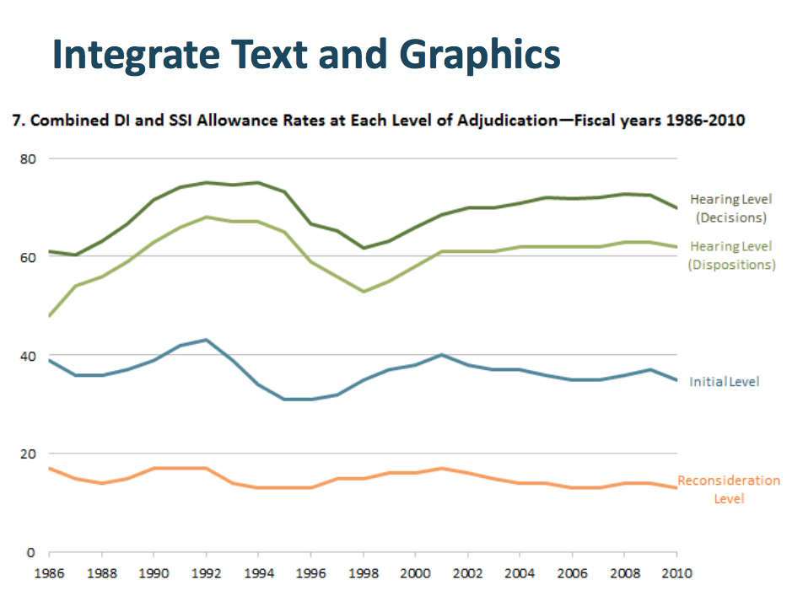
Example of accentuating communication
Adapted from Telling Visual Stories About Data, Congressional Budget Office, Fontaine, 2014.

Slide 24
Once you have an idea of what you want to present and to whom…
Consider the following steps and design elements
Compose
Organizing elements, defining relationships
Abstract
Define and represent the meaning
Color (our favorite)
Chose your colors to highlight relationships, label, attract or downplay interest
Layer
Overlap multiple objects to create relationships
Refine
Edit and simplify to the most direct communication possible
Based on Frankel and DePace, 2012.

Slide 25
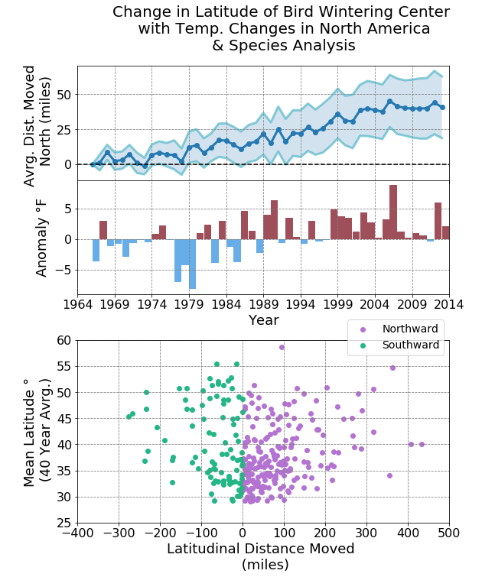
Element 1 – Composition – how your figure “flows” What relationships are you highlighting?
This is an example from the CLaSP course (Lab 2). We merged this frist axis, to make them more comparable for the reader
While these data are of different TYPE (not time dependent) so we keep them separate
Figure from https://github.com/astro-abby/
Based on Frankel and DePace, 2012.

Slide 26
Element 1 – Composition – how your figure “flows” What relationships are you highlighting?
You can also have a single figure display a flow
This is a relational diagram, made with a program called Circos. Here the flow is first circular then across as designated by the connection lines.
Don’t be afraid to try new things!
Source: Azari et al., 2018.
Based on Frankel and DePace, 2012.

Slide 27
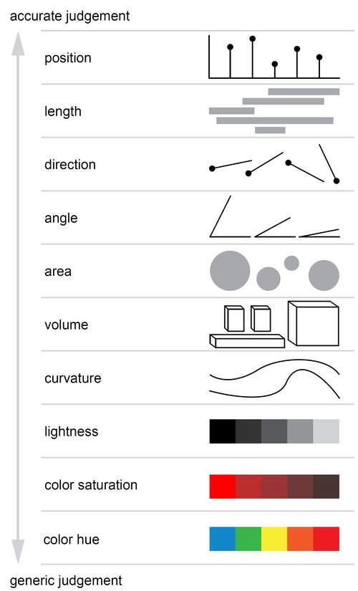
Element 2 – Abstract What type of abstraction is supposed to represent your data? Define and representation.
Some general guidelines from hallmark graphics study on accuracy perception by Cleveland & McGill
Source: Adapted from Cleveland & McGill – From
https://www.gabrielaplucinska.com/blog/2017/8/7/pie-charts

Slide 28
Element 2 – Abstract This is where some of the quotable “rules” come from – if you can create a figure that avoids relying on color hue or area for direction or position it is usually recommended
Source: Adapted from Cleveland & McGill – From
https://www.gabrielaplucinska.com/blog/2017/8/7/pie-charts

Slide 29
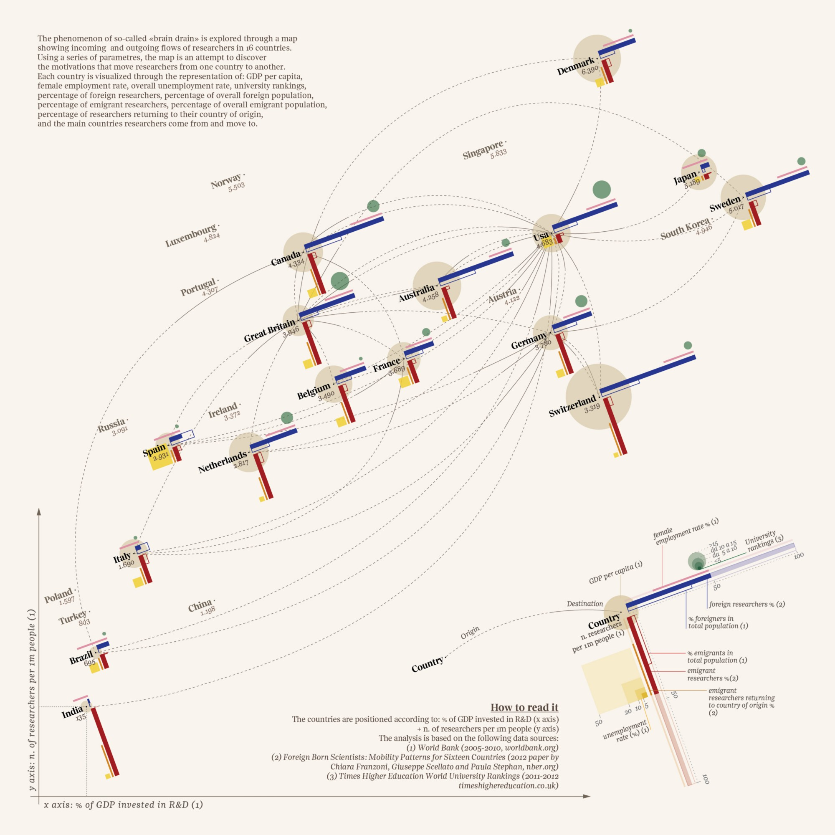
Element 2 – Abstract You can get rather creative here – for example – This chart is creating a new style of abstraction to communicate “brain drain” between 16 countries
Source: The global Brain Drain — Accurat for La Lettura, Corriere della Sera

Slide 30
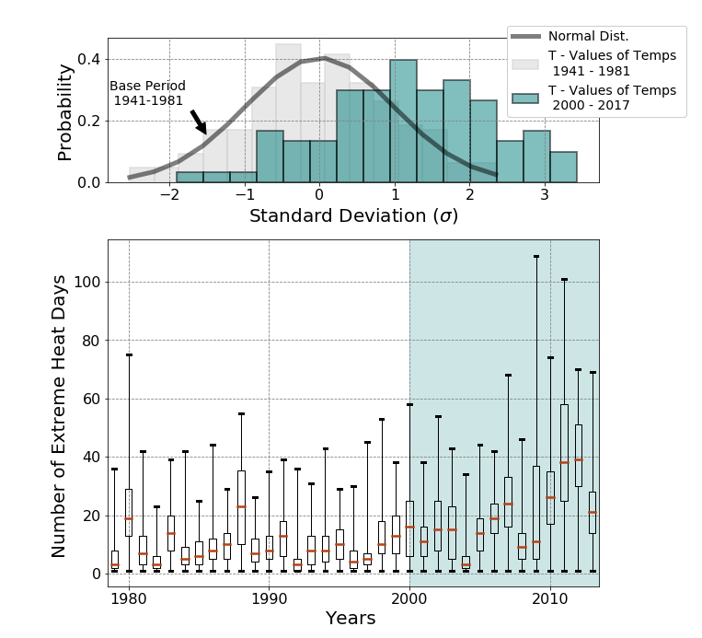
Element 3 – Color Use color to highlight, to show relationships, to indicate values “colors are the mother tongue of the subconscious” – Carl Jung
We spend a lot of our time in this class with colors –
Here we tied together two times periods by signifying color
Figure from https://github.com/astro-abby/
Based on Frankel and DePace, 2012.

Slide 31
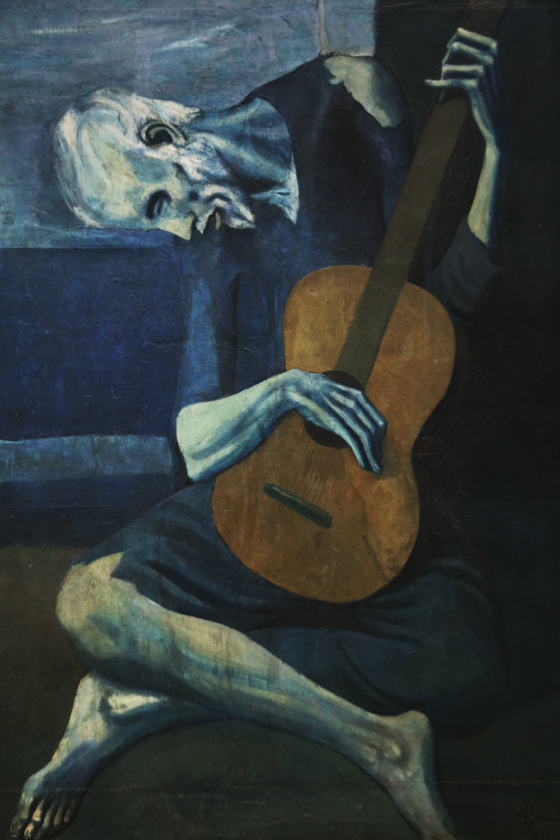
Element 3 – Color Some guidelines of color in design
Consider Conveying Information Or Meaning By Color Choice –
Red usually will highlight something extreme or something “hot”, blue is more “sedate”
In general if you are graphing a location - green is good for land, blue for ocean etc
Based on Adams, 2008.
Old Guitarist – Pablo Picasso

Slide 32
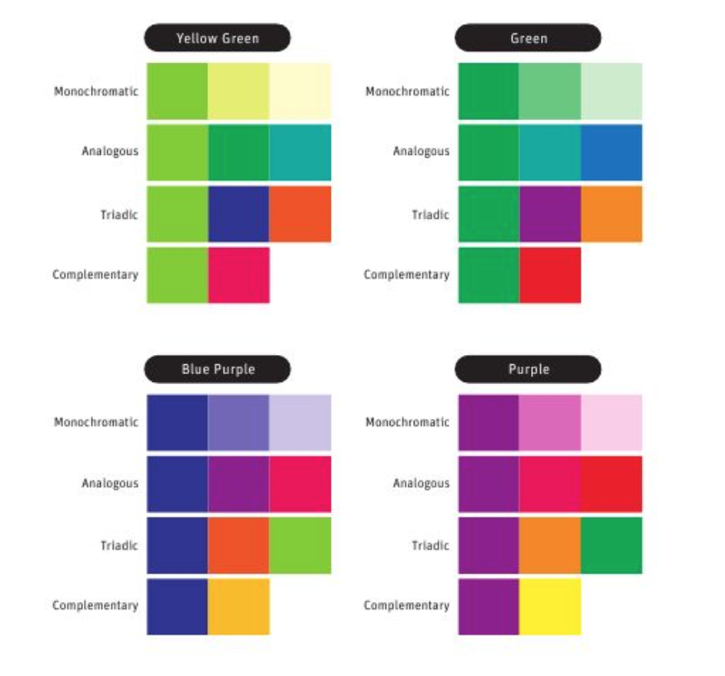
Element 3 – Color Some guidelines of color in design
Once you choose a color – create color harmony
Suggestions for building a color palette –
Choose a primary color – and then accent around it
Do not overload on colors, usually 5 or less is good enough
Play around – what looks good? What accentuates difference?
Based on Adams, 2008.

Slide 33
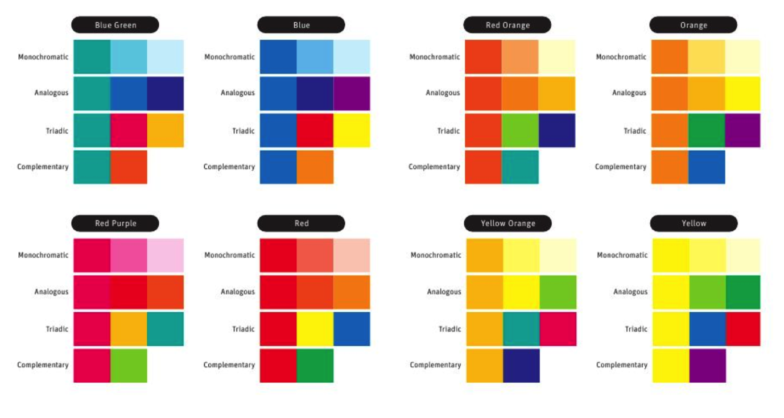
Element 3 – Color Some guidelines of color in design
Example of color choice in action – these are classic pallets to put together – you can find more of course online
Based on Adams, 2008.

Slide 34
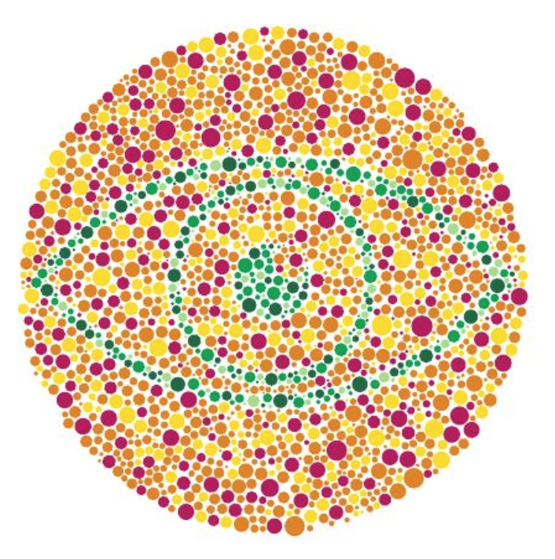
Element 3 – Color Some guidelines of color in design
People see colors differently
Good colors to avoid:
Red & Green in combo
Resource: You can get “hex codes” and palettes from a variety of websites – my favorites [1], [2], [3]
Based on Adams, 2008.

Slide 35
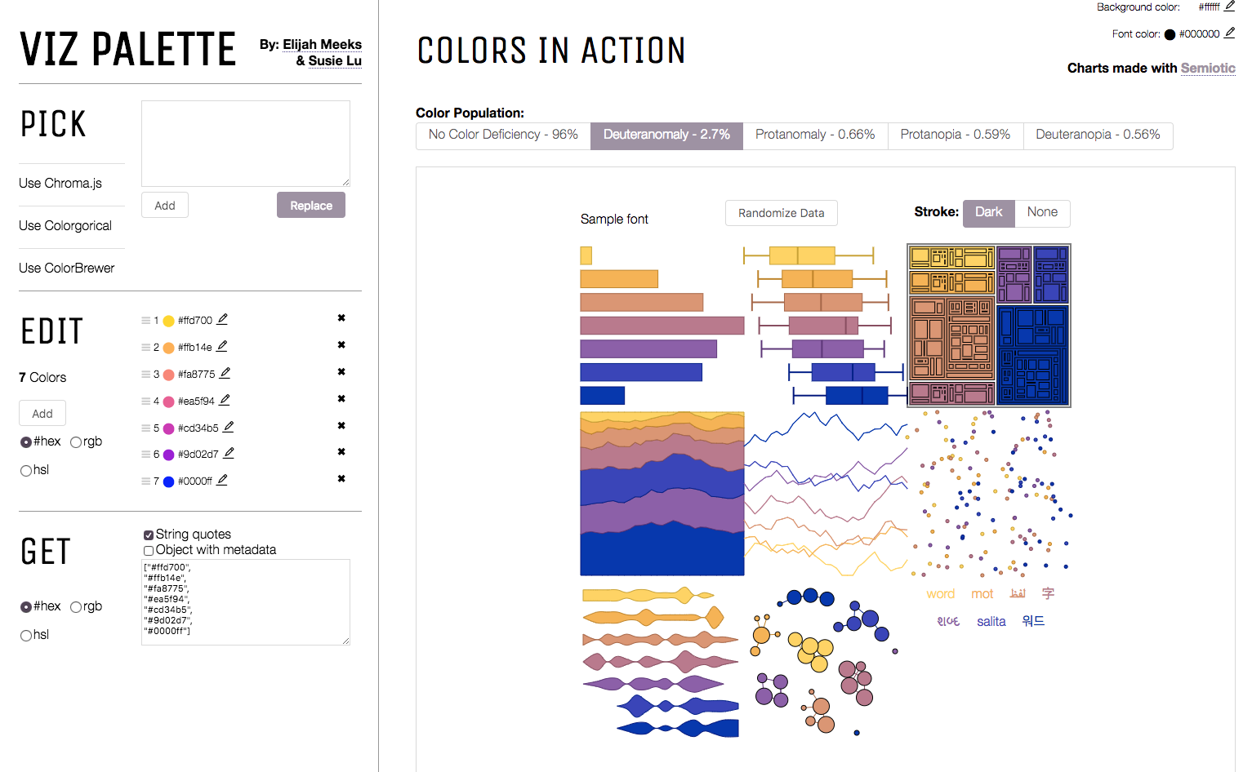
Element 3 – Color Some guidelines of color in design
People see colors differently
Good colors to avoid:
Red & Green in combo
Resource: You can get “hex codes” and palettes from a variety of websites – my favorites [1], [2], [3]
http://projects.susielu.com/viz-palette
Based on Adams, 2008.

Slide 36
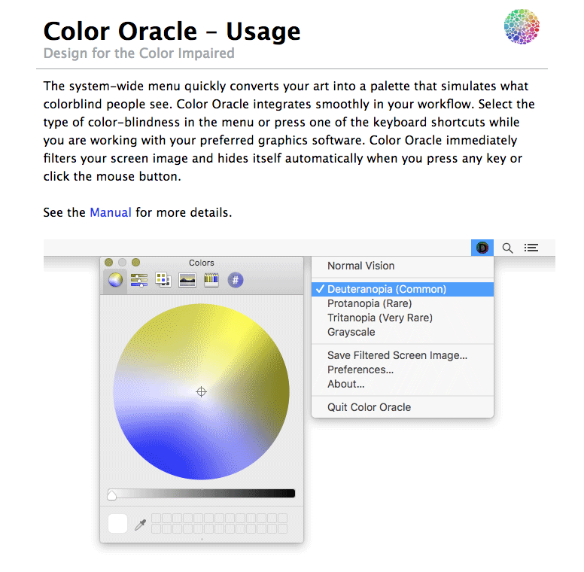
Element 3 – Color Some guidelines of color in design
People see colors differently
Good colors to avoid:
Red & Green in combo
Resource: You can get “hex codes” and palettes from a variety of websites – my favorites [1], [2], [3]
https://colororacle.org/usage.html
Based on Adams, 2008.

Slide 37
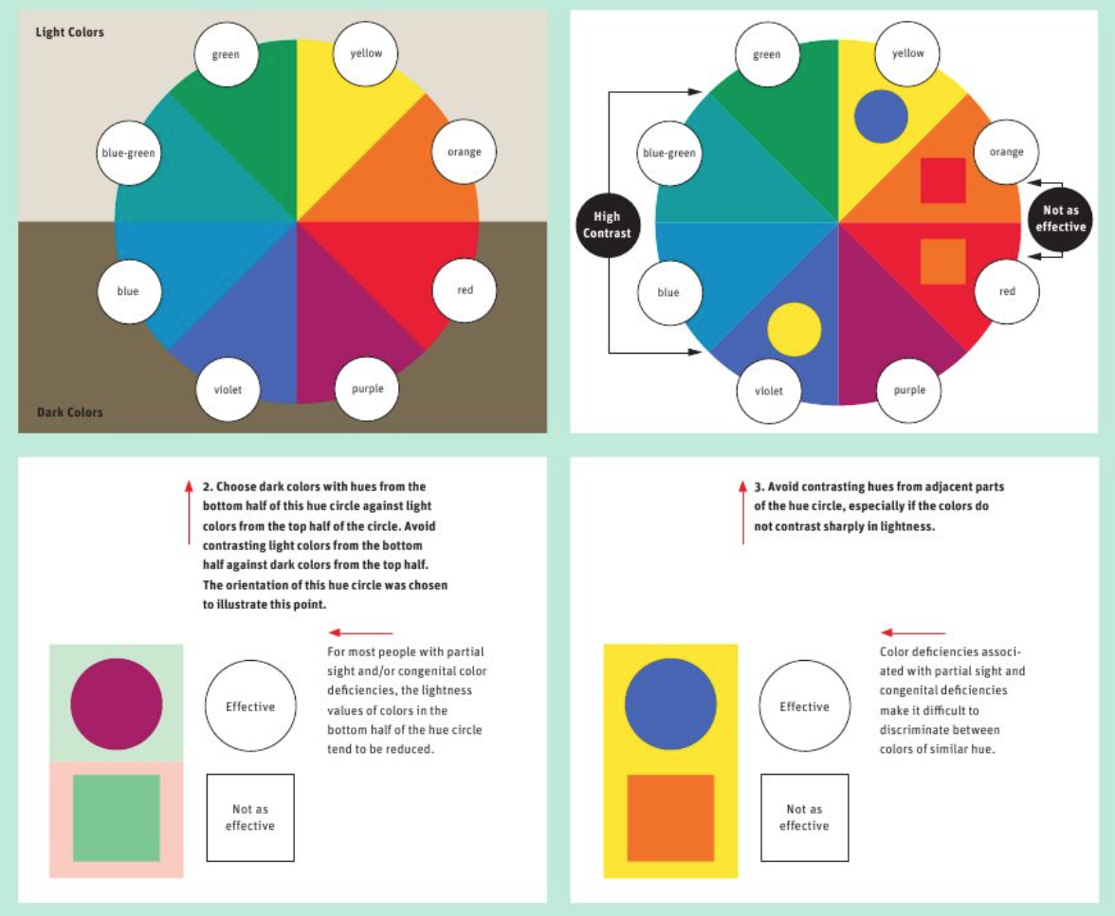
Element Color Some guidelines of color in design
People see colors differently
Try to vary in hue AND saturation
Feel free to experiment!
Based on Adams, 2008.

Slide 38
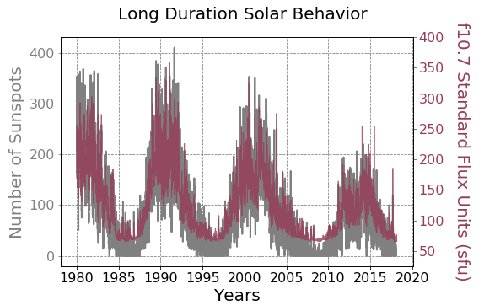
Element 4 – Layering Add layers to express meaning
This graphic is produced in Lab 7. We are using layers to express potential relation
Figure from https://github.com/astro-abby/
Based on Frankel and DePace, 2012.

Slide 39
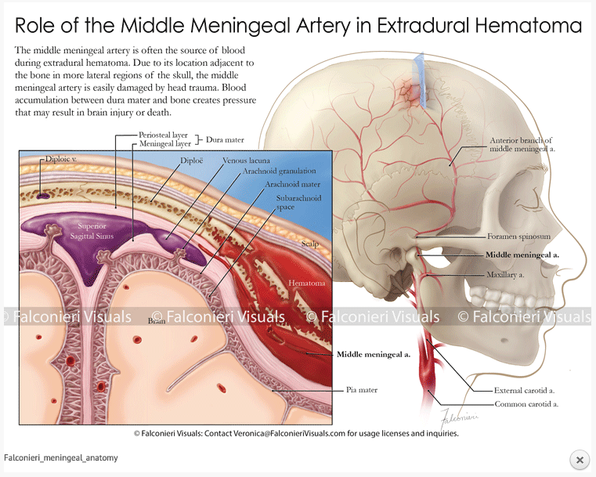
Element 4 – Layering Add layers to express meaning
From V. Falconieri –
http://falconierivisuals.com/

Slide 40
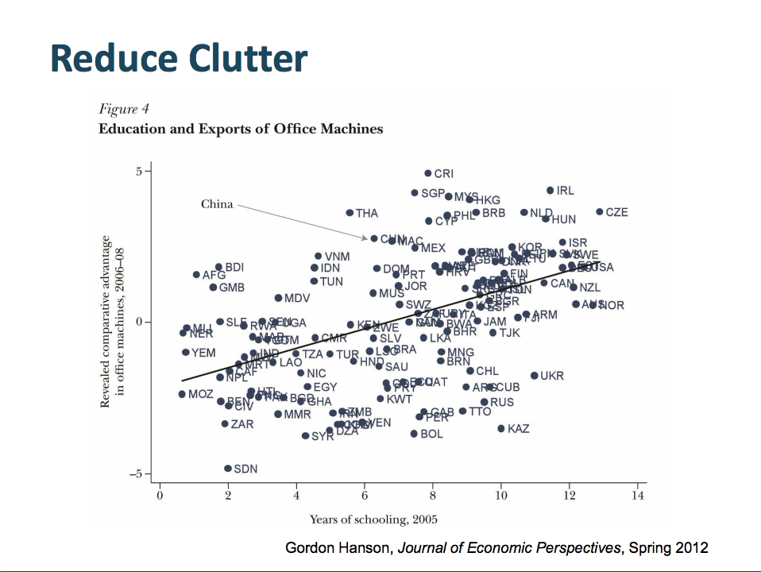
Element 5 – Refine Once you have a good layout – try seeing how you can simply it to express the most meaning
Based on Frankel and DePace, 2012.
Adapted from Telling Visual Stories About Data, Congressional Budget Office, Fontaine, 2014.

Slide 41
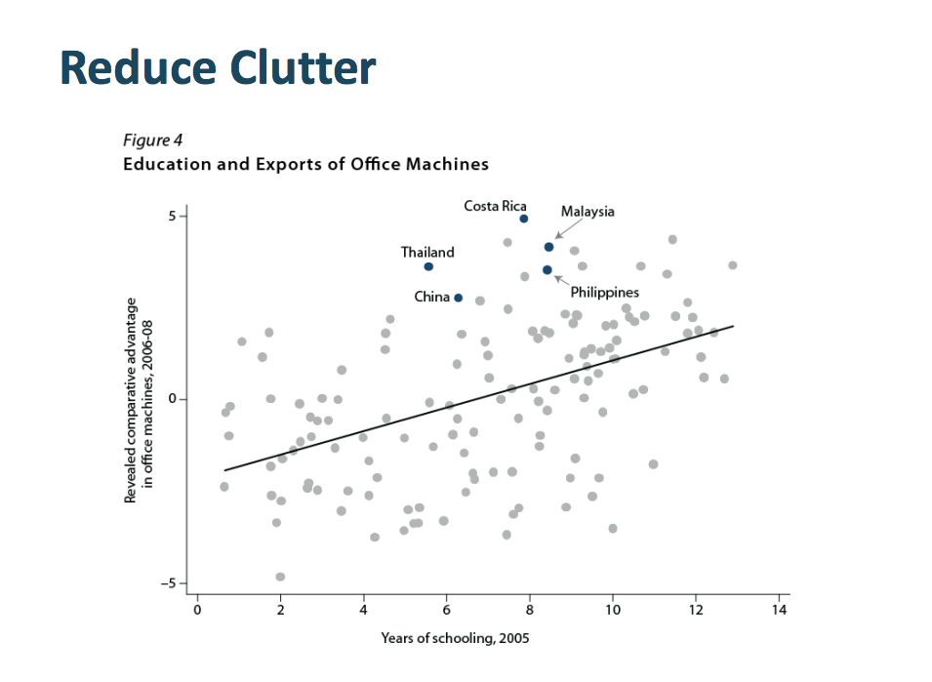
Element 5 – Refine Once you have a good layout – try seeing how you can simply it to express the most meaning
Based on Frankel and DePace, 2012.
Adapted from Telling Visual Stories About Data, Congressional Budget Office, Fontaine, 2014.

Slide 42
What we’ve learned
When starting a visualization for data consider what is the main point of my graphic and what is my audience?
Is my graphic explanatory or exploratory?
How will it be used?
What is the first thing you want your audience to see?
When making a figure consider:
Composition
Abstraction
Coloring (make sure to consider colorblind palettes!)
Layering
Refining

Slide 43
Let’s put what we’ve learned into practice
Consider these as we watch the following video - http://players.brightcove.net/679256133001/NkgrDczuol_default/index.html?videoId=5373954480001
This won the NSF Expert’s Choice award in 2017 for best video visualization.
Think as we watch this how these use the elements to address their audience
Composition
Abstraction
Coloring
Layering
Refining

Slide 44
Let’s put what we’ve learned into practice
Now on your desk discuss the screenshots with a friend
…and how these use the elements to address their audience
Composition
Abstraction
Coloring
Layering
Refining

Slide 45
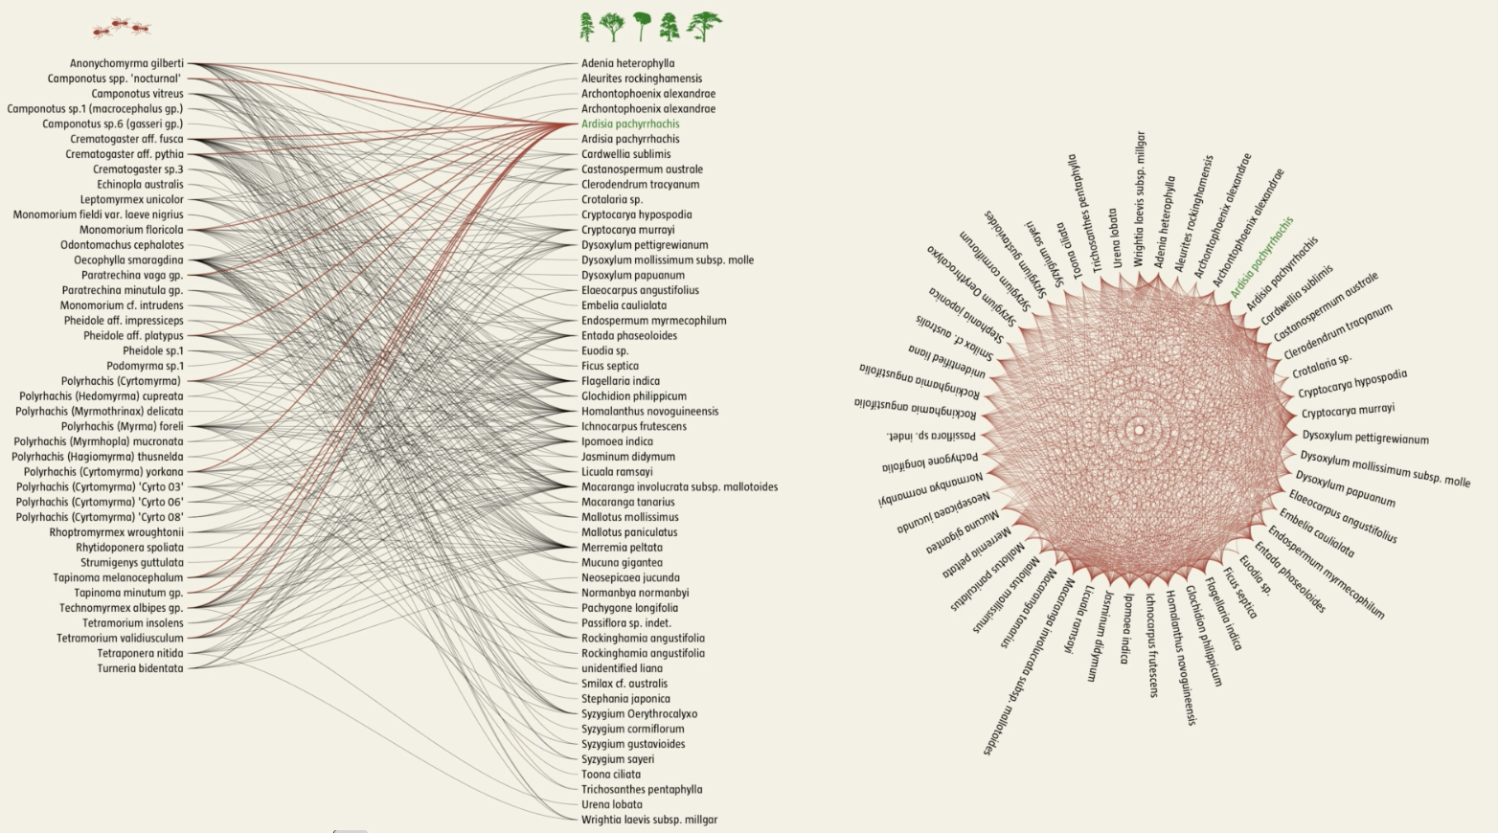
Source: Network Earth, Mauro Martino, Jianxi Gao, Baruch Barzel, Albert-László Barabási. Narration: Shamini Bundell

Slide 46
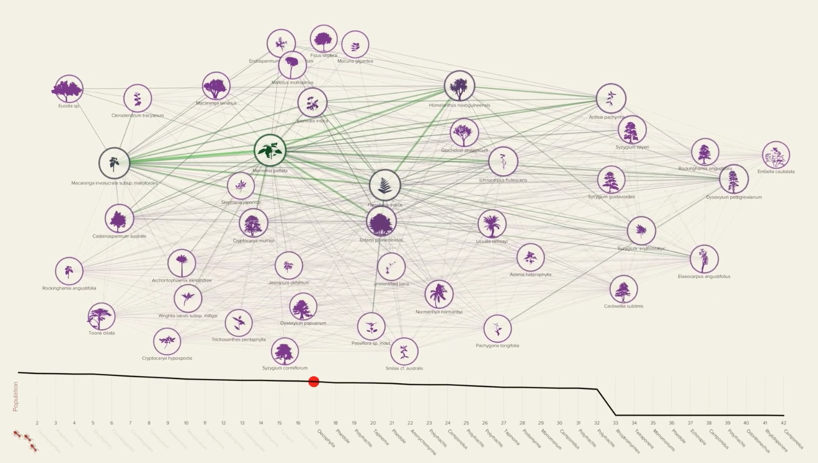
Source: Network Earth, Mauro Martino, Jianxi Gao, Baruch Barzel, Albert-László Barabási. Narration: Shamini Bundell

Slide 47
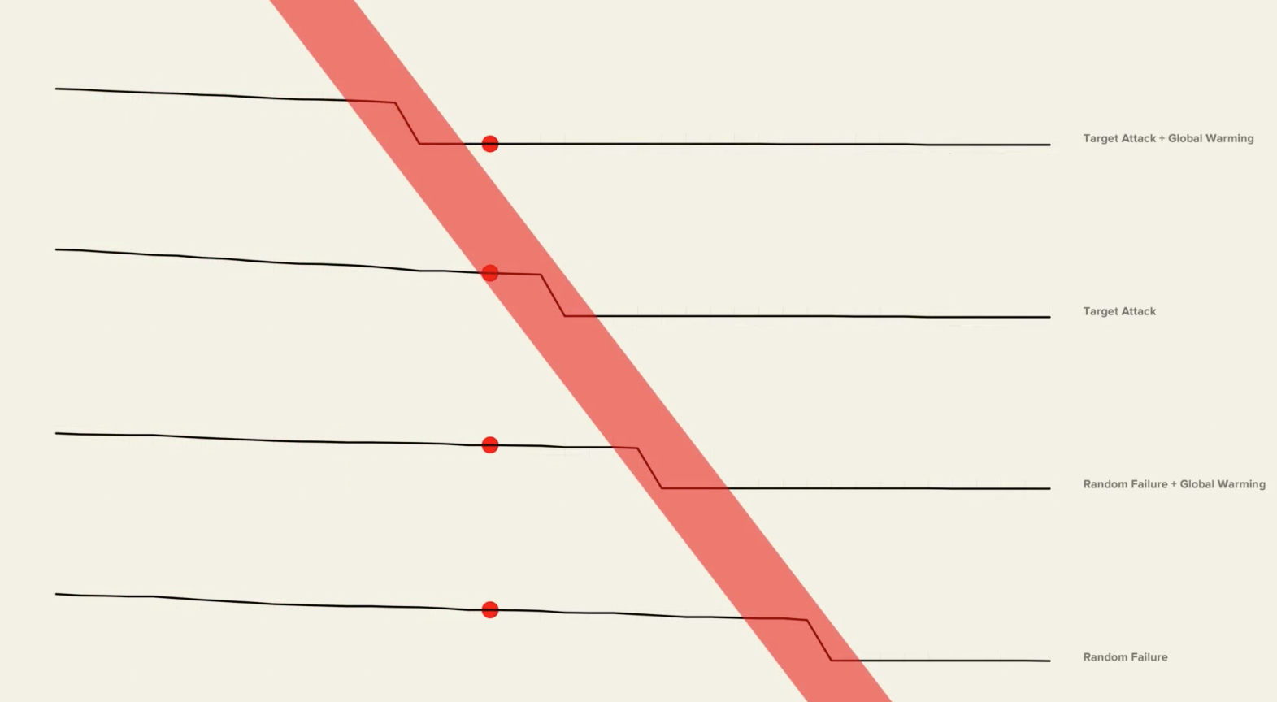
Source: Network Earth, Mauro Martino, Jianxi Gao, Baruch Barzel, Albert-László Barabási. Narration: Shamini Bundell

